Slide 1


DS 202 Final Presentation
Sonya Haan
Connor Hergenreter
Andrew Maloney
Elaine Oldbear

Slide 2
Military Expenditure
Arms Imported
Military Personnel
Global Firepower
Dataset Background
Started with Military Expenditure
Searched for data to explain what militaries spend money on
Current USD
Share of GDP
Notes:
We started our project by working with a dataset from the Stockholm International Peace Research Institute (SIPRI) about the military expenditures of 172 different countries from the year 1949 to 2017.
For this dataset, SIPRI defines military expenditure as any spending on the military in general. This includes money spent on:
personnel (i.e. the salaries and benefits of troops and civilian staff)
operations and maintenance (i.e. spending on general supplies, services and transport)
military and non-military equipment
construction of military bases
research and development.
Though the military expenditure dataset takes into account all these categories of military spending, it does not break down spending by category. It only reports the total military expenditure for each year.
Originally, we were only working with the military expenditure data, but as SIPRI states, “[military spending] is a financial measure, measuring inputs, and does not necessarily measure military capability.”
We didn’t feel that yearly military expenditure alone could tell the whole story, so we looked deeper into what militaries are spending their money on.
During this search we found 3 other datasets to help us analyze militaries:
Arms Imported
Military Personnel
Global Fire Power
Arms Imported
SIPRI uses a unit of measure called the trend-indicator value to measure the volume of international transfers of major conventional weapons. The trend-indicator value, or TIV, measures transfers of military capability, not the financial value of the arms transfers.
“Arms transfers cover the supply of military weapons through sales, aid, gifts, and those made through manufacturing licenses. Data cover major conventional weapons such as aircraft, armored vehicles, artillery, radar systems, missiles, and ships designed for military use. Excluded are transfers of other military equipment such as small arms and light weapons, trucks, small artillery, ammunition, support equipment, technology transfers, and other services. Figures are SIPRI Trend Indicator Values (TIVs) expressed in US$ m. at constant (1990) prices. A '0' indicates that the value of deliveries is less than US$0.5m. “
Military Personnel
Presents the armed forces personnel, as a percentage of total labor force. (Data ranges from 1990 to 2016)
“Armed forces personnel are active duty military personnel, including paramilitary forces if the training, organization, equipment, and control suggest they may be used to support or replace regular military forces. Labor force comprises all people who meet the International Labour Organization's definition of the economically active population. “
Global Firepower

Slide 3
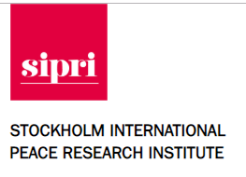
Obtaining the Data
5 data frames
Downloaded data as Excel files
Read in data using read_excel
SIPRI | Kaggle
Military Expenditure: Current USD Military Expenditure: Share of GDP Arms Imported Military Personnel | Global Firepower

Slide 4
Cleaning the Data
Cleaned Excel file before loading data into R
Removed embedded pictures and links
Changed “Year” and “Value” variable type to numeric
Gathered all year columns
Current USD for example, had 71 columns: Country, Notes, 1949, … , 2017
Had to input iso3c manually for some countries
Joined military expenditure data with world map data
Joined on the ‘iso3c’ value
Introduced new variable ‘iso3c’ country code

Slide 5
QUESTION 1
How do the strongest and weakest militaries compare? Can we conclude what determines a military’s strength?

Slide 6
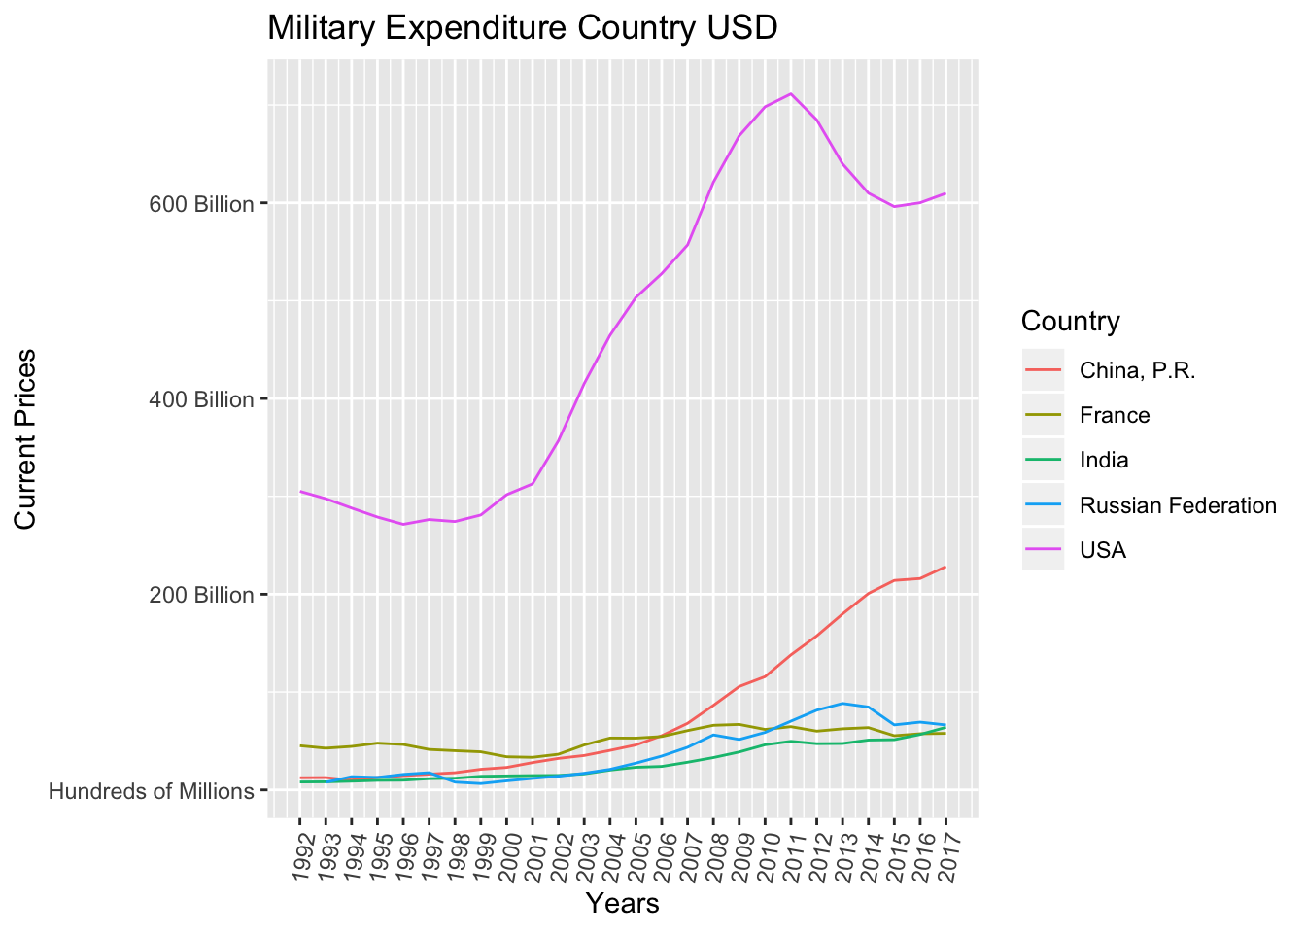
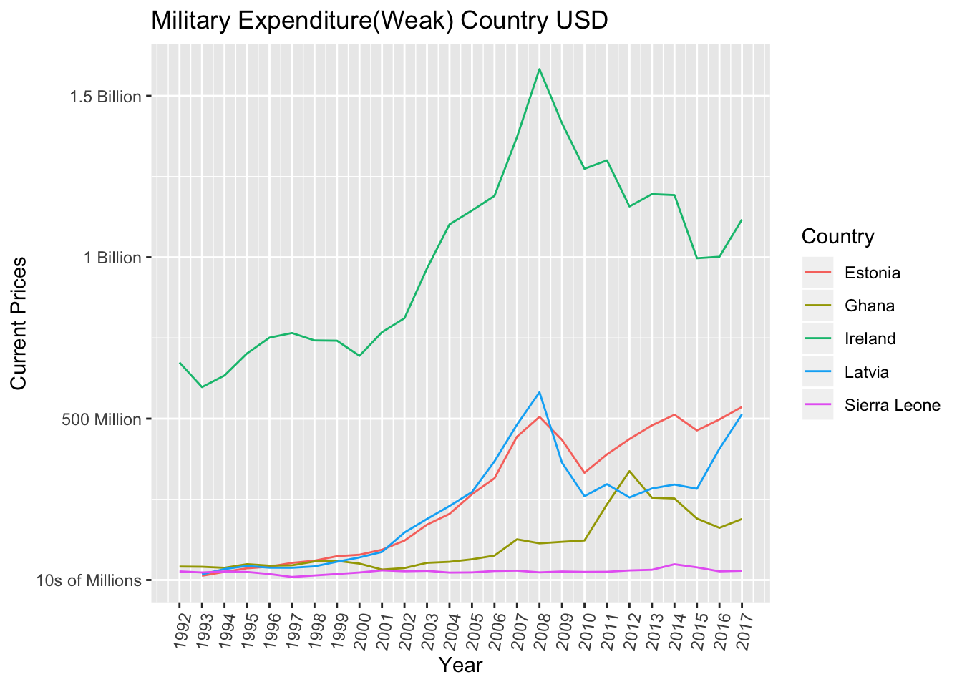
Military Expenditure of Strong and Weak Militaries
Notes:
China: The figures for China have been revised in this edition of the database based on revised estimates for additional military research & development spending. The figures are for estimated total military expenditure, including estimates for items not included in the official defence budget. On the estimates in local currency and as share of GDP for the period 1989-96, see Shaoguang Wang, The military expenditure of China, 1989 to 98, SIPRI Yearbook 1999: Armaments, Disarmament and International Security (Oxford University Press: Oxford, 1999), pp. 349. The estimates for the years 1997-2017 are based on publicly-available figures for official military expenditure and some other items, and estimates for other items based on Prof. Wang's methodology or other methods based on new information. For the most recent years, where no official data is available for certain items, estimates are based on either the percentage change in official military expenditure, recent trends in spending in the same category, and in the case of the commercial earnings of the Peoples Liberation Army (PLA), on the assumption of a gradual decrease. See Sources and Methods, http://www.sipri.org/research/armaments/milex/milex_database/copy_of_sources_methods
France: The figures for France from 2006 are calculated with a new methodology due to a change in the French budgetary system and financial law. Military spending includes a supplementary budget of 1.5 bn euros extra allocated to "defence" in 2016 and 700 mil euros in 2017. This is added to the original LdF budget.
India: The figures for India include expenditure on the paramilitary forces of the Border Security Force, the Central Reserve Police Force, the Assam Rifles, the Indo-Tibetan Border Police and, from 2007 the Sashastra Seema Bal but do not include spending on military nuclear activities.
Russia: For the sources and methods of the military expenditure figures for the USSR and Russia, see Cooper, J., 'The military expenditure of the USSR and the Russian Federation, 1987–97', SIPRI Yearbook 1998: Armaments, Disarmament and International Security (Oxford University Press: Oxford, 1998), appendix 6D, pp. 243–59.
USA: All figures for the USA are for financial year (1 Oct. of the previous year-30 Sep. of the stated year) rather than calendar year.
Estonia: Estonia merged their Border Guard Service with the National Police in 2010, and are no longer classed as a paramilitary force by SIPRI. This accounts for much of the decrease in Estonian military spending in 2010.
Ghana: Ghana has had multiple changes of financial year. Up to and including 1966, the financial year is from January to December. From 1967-68 to 1969-70, the financial year is from July to June. From 1970 to 1979, the financial year is from January-December. (Thus the financial years beginning 1969 and 1970 overlap). Then there are financial years from July 1980 to June 1981, and from July 1981 to June 1982. Finally from 1982 onwards the financial year is from January to December.
Latvia: Latvia adopted the Euro on the 1st January 2014, at a transition rate of €1 = 0.702804 lats. All figures have been converted into Euros using this rate. Figures for Latvia do not include allocations for military pensions paid by Russia, which averaged 27 million lats per year over 1996-1998.
Sierra Leone: The figures for Sierra Leone in 1998 and 1999 are not available due to the coup d'etat and subsequent civil war. It is not clear whether the data before and after these years are based on the same definition.

Slide 7
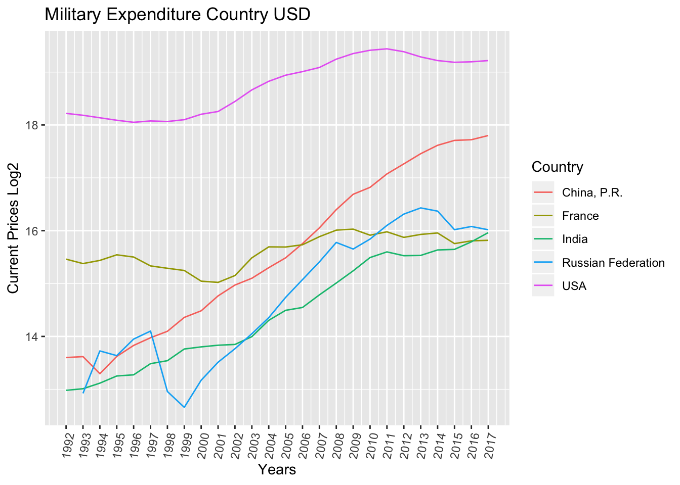
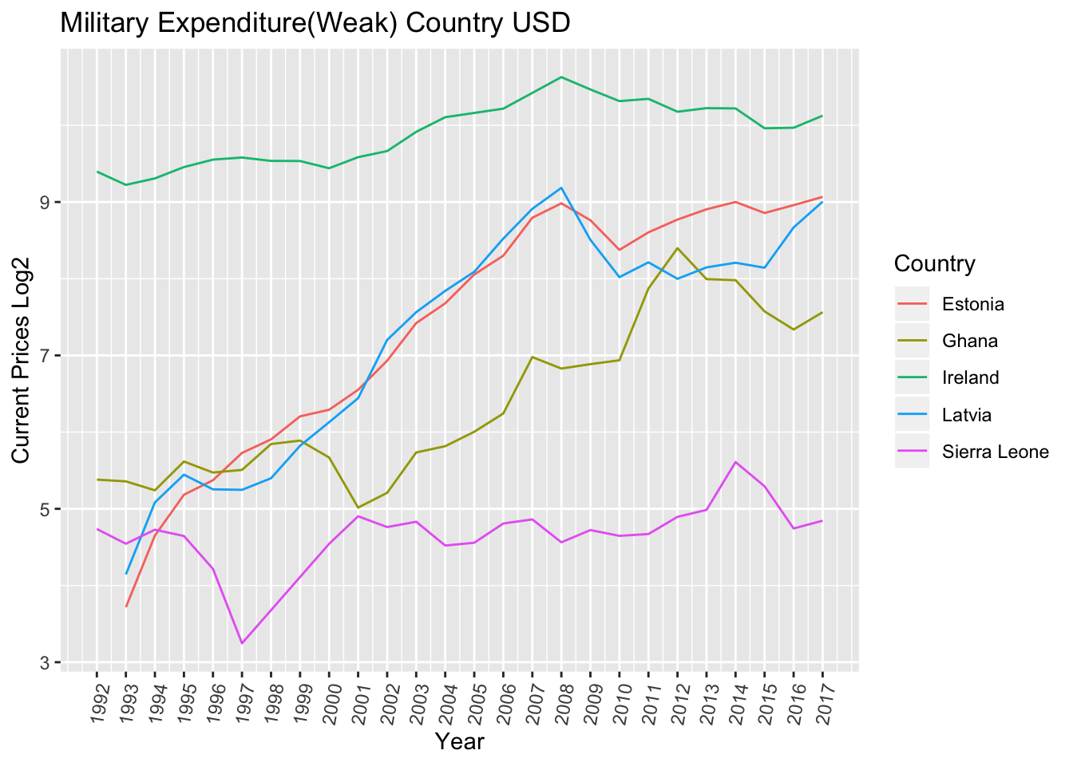
Log₂(Military Expenditure) of
Strong and Weak Militaries
Notes:
1994 Yemen Civil War
USA supported Republic of Yemen
2001 (9/11)
Al-Qaeda attacks against US
2003 Iraq War
Us forces remained in Iraq until 2011
2014 – Present: Rise of ISUS
US-led coalition engaged in airstrikes against ISIS in August 2014
By 2017 ISIS had lost 95% of its territory
2015
Russia becomes involved with Syrian Civil War

Slide 8
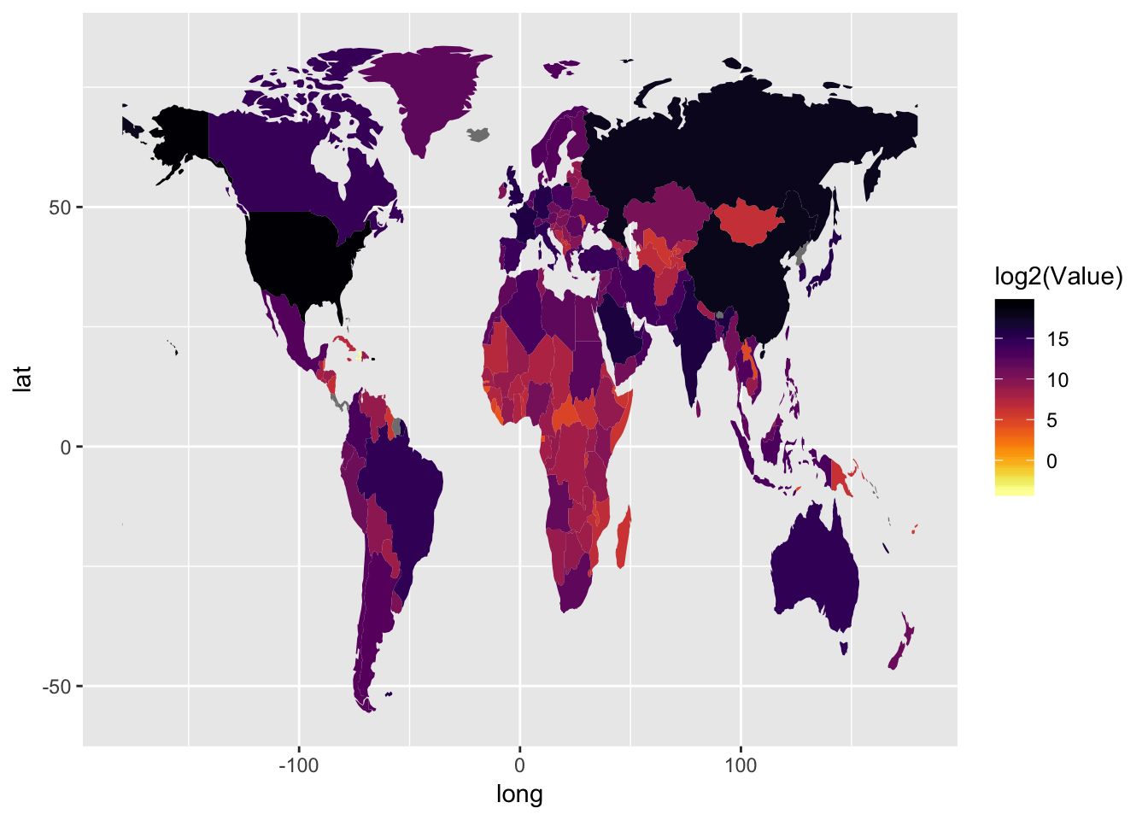
Military Expenditure World Map

Slide 9
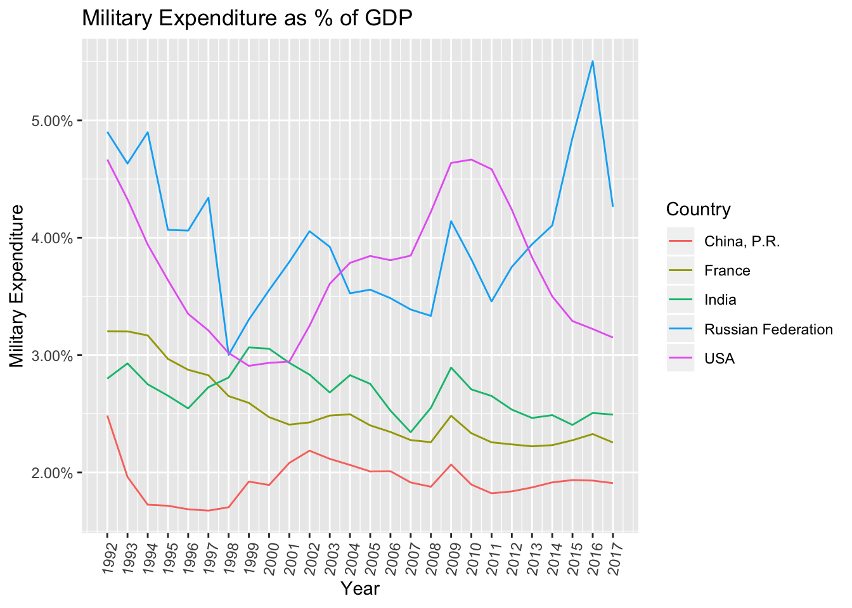
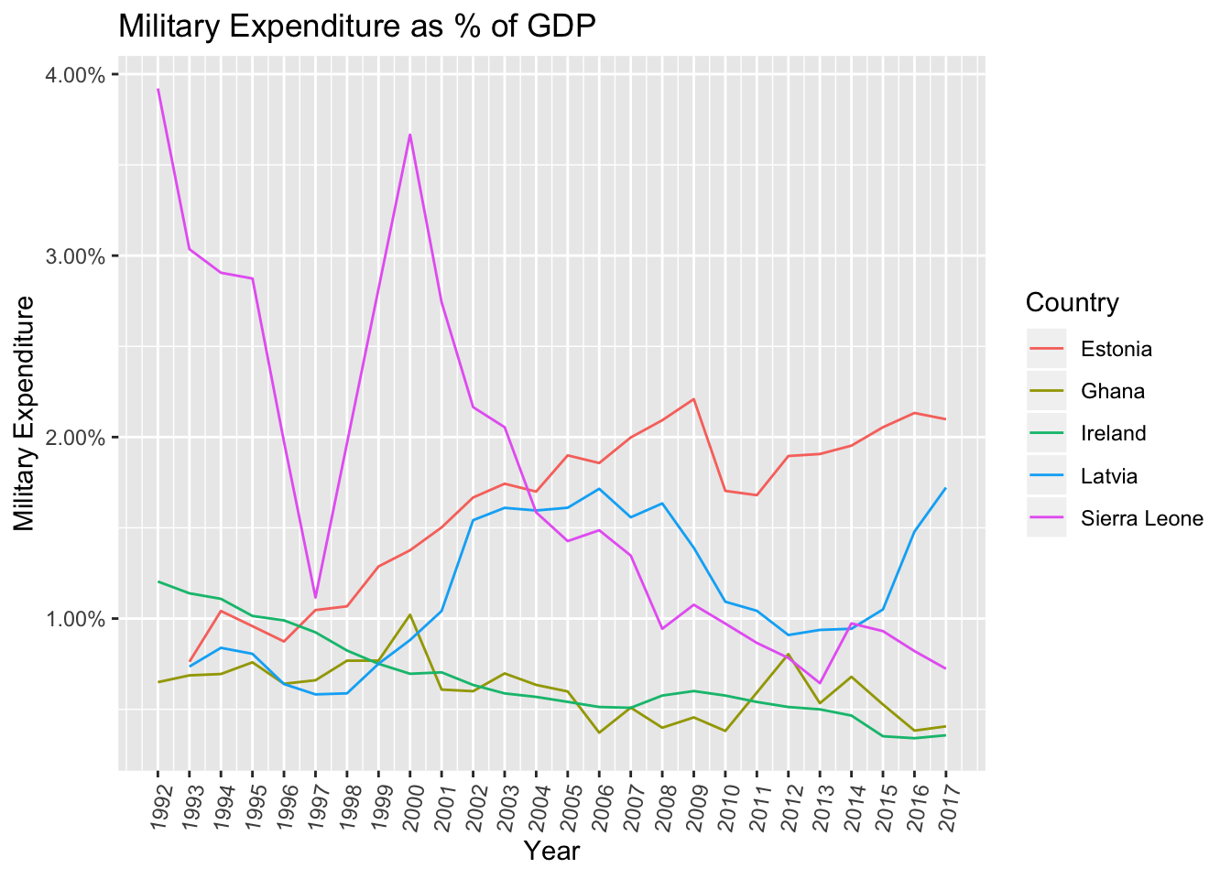
Military Expenditure
as Share of GDP

Slide 10
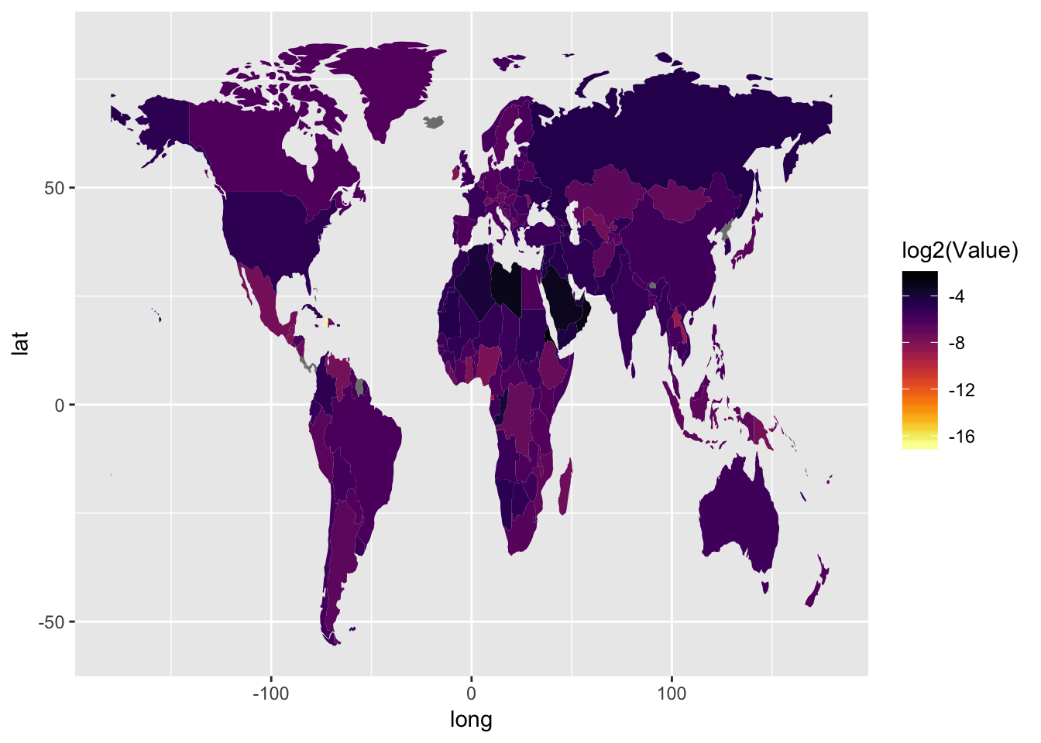
Expenditure as share of GDP World Map

Slide 11
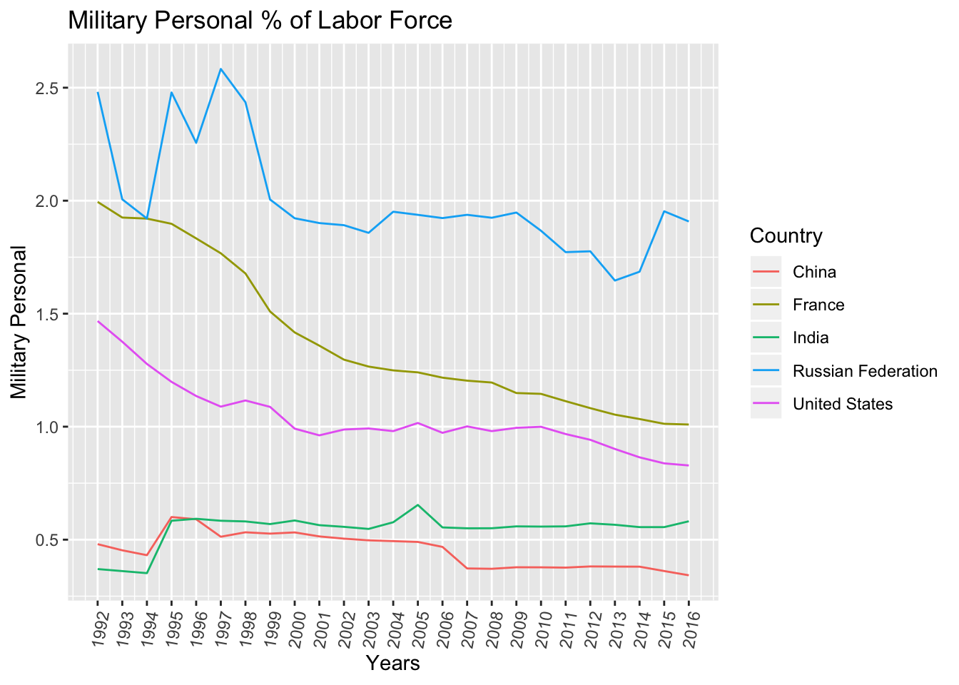
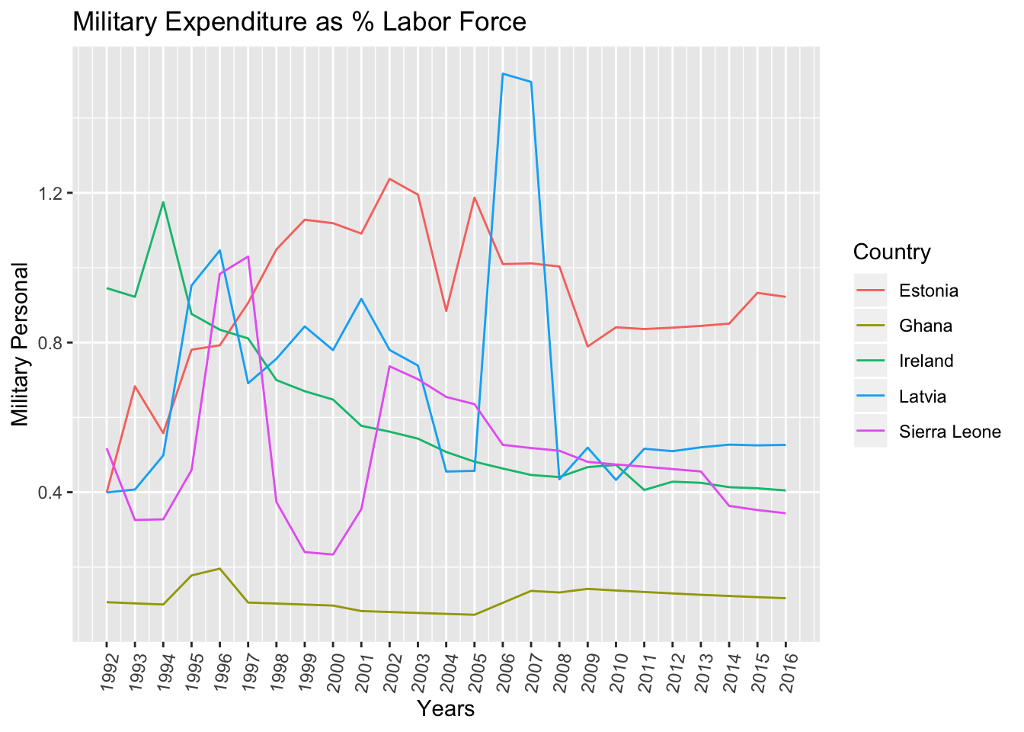
Military Personnel
(as % of total labor force)
Notes:
China: On 1 July 1997 China resumed its exercise of sovereignty over Hong Kong; and on 20 December 1999 China resumed its exercise of sovereignty over Macao. Unless otherwise noted, data for China do not include data for Hong Kong SAR, China; Macao SAR, China; or Taiwan, China. The new base year is 2015.
France: A simple multiplier is used to convert the national currencies of EMU members to euros. The following irrevocable euro conversion rate was adopted by the EU Council on January 1, 1999: 1 euro = 6.55957 French franc. Please note that historical data before 1999 are not actual euros and are not comparable or suitable for aggregation across countries.
India: Fiscal year end: March 31; reporting period for national accounts data: FY. Based on official government statistics; the new base year is 2011/12. India reports using SNA 2008.
Estonia: A simple multiplier is used to convert the national currencies of EMU members to euros. The following irrevocable euro conversion rate entered into force on January 1, 2011: 1 euro = 15.6466 Estonian kroon. Please note that historical data are not actual euros and are not comparable or suitable for aggregation across countries.
Ghana: Base year change from 2006 to 2013 - national data revised.
Ireland: A simple multiplier is used to convert the national currencies of EMU members to euros. The following irrevocable euro conversion rate was adopted by the EU Council on January 1, 1999: 1 euro = 0.787564 Irish pound. Please note that historical data before 1999 are not actual euros and are not comparable or suitable for aggregation across countries.
Latvia: A simple multiplier is used to convert the national currencies of EMU members to euros. The following irrevocable euro conversion rate entered into force on January 1, 2014: 1 euro = 0.702804 Latvian lats. Please note that historical data are not actual euros and are not comparable or suitable for aggregation across countries. Based on data from EUROSTAT, the new reference year is 2010.
Sierra Leone: Fiscal year end: June 30; reporting period for national accounts data: CY.

Slide 12
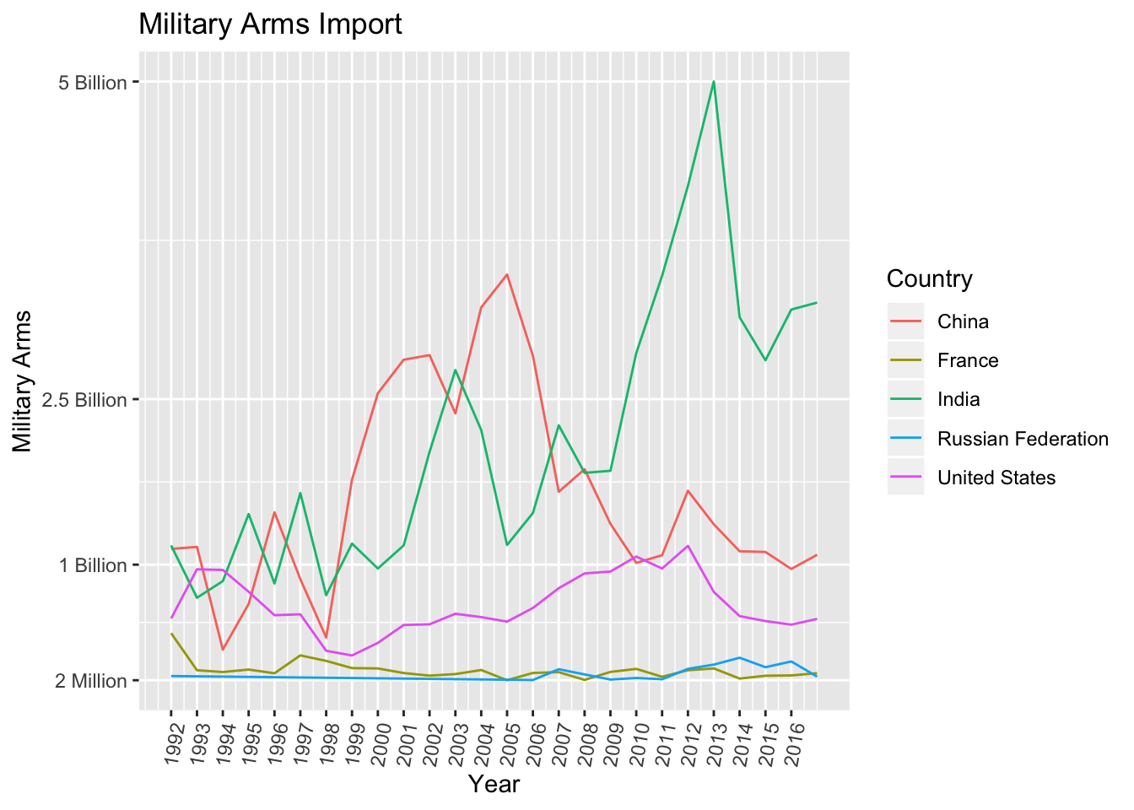
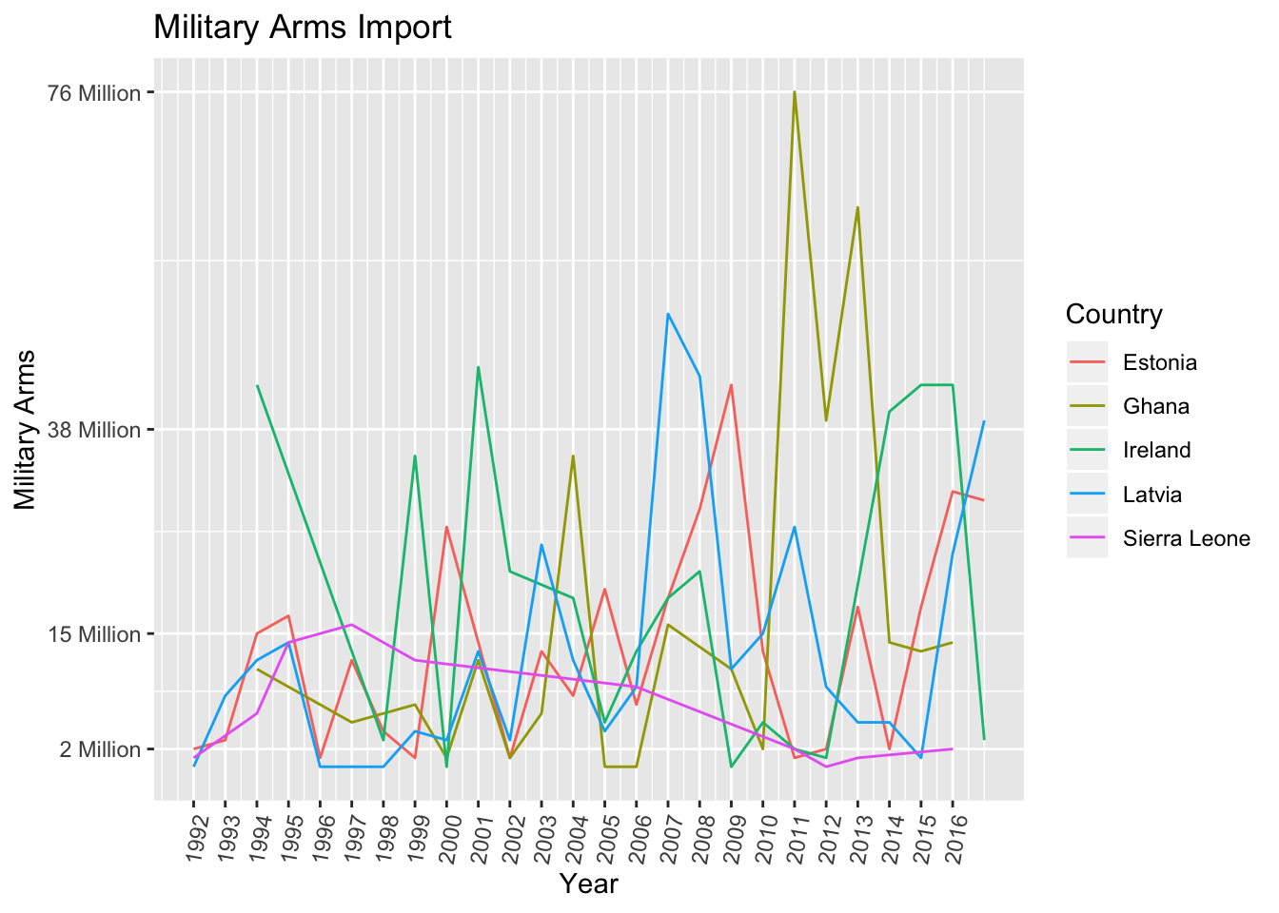
Military Arms
Imports
Notes:
China: NBS - National Bureau of Statistics and Bank's country office ; Source of population estimates: National Bureau of Statistics. On 1 July 1997 China resumed its exercise of sovereignty over Hong Kong; and on 20 December 1999 China resumed its exercise of sovereignty over Macao. Unless otherwise noted, data for China do not include data for Hong Kong SAR, China; Macao SAR, China; or Taiwan, China. The new base year is 2015.
France: OECD (Organization for Economic Cooperation and Development) ; Source of population estimates: Eurostat, United Nations World Population Prospects. Including the French overseas departments of French Guiana, Guadeloupe, Martinique, Réunion, as well as Mayotte. A simple multiplier is used to convert the national currencies of EMU members to euros. The following irrevocable euro conversion rate was adopted by the EU Council on January 1, 1999: 1 euro = 6.55957 French franc. Please note that historical data before 1999 are not actual euros and are not comparable or suitable for aggregation across countries.
India: Central Statistics Office ; Source of population estimates: UN Population Division's World Population Prospects 2019 PROVISIONAL estimates. Not for circulation. Subject to change. Fiscal year end: March 31; reporting period for national accounts data: FY. Based on official government statistics; the new base year is 2011/12. India reports using SNA 2008.
Russia: Rosstat ; Source of population estimates: Russian Federation Federal State Statistics Service (its January 1st populations were adjusted to mid-year populations by using geometric mean), 1979 Census, 1989 Census.
USA: OECD (Organization for Economic Cooperation and Development) ; Source of population estimates: U.S. Census Bureau
Estonia: OECD (Organization for Economic Cooperation and Development) ; Source of population estimates: Eurostat. A simple multiplier is used to convert the national currencies of EMU members to euros. The following irrevocable euro conversion rate entered into force on January 1, 2011: 1 euro = 15.6466 Estonian kroon. Please note that historical data are not actual euros and are not comparable or suitable for aggregation across countries.
Ghana: Bureau of Statistics ; Source of population estimates: UN Population Division's World Population Prospects 2019 PROVISIONAL estimates. Not for circulation. Subject to change.
Ireland: OECD (Organization for Economic Cooperation and Development) ; Source of population estimates: Eurostat. A simple multiplier is used to convert the national currencies of EMU members to euros. The following irrevocable euro conversion rate was adopted by the EU Council on January 1, 1999: 1 euro = 0.787564 Irish pound. Please note that historical data before 1999 are not actual euros and are not comparable or suitable for aggregation across countries.
Latvia: OECD (Organization for Economic Cooperation and Development) ; Source of population estimates: Eurostat. A simple multiplier is used to convert the national currencies of EMU members to euros. The following irrevocable euro conversion rate entered into force on January 1, 2014: 1 euro = 0.702804 Latvian lats. Please note that historical data are not actual euros and are not comparable or suitable for aggregation across countries. Based on data from EUROSTAT, the new reference year is 2010.
Sierra Leone: Statistics Sierra Leone, IMF Article IV ; Source of population estimates: UN Population Division's World Population Prospects 2019 PROVISIONAL estimates. Not for circulation. Subject to change. Fiscal year end: June 30; reporting period for national accounts data: CY.

Slide 13
Global Firepower Summary
Total Aircraft Strength
Min | 1305
1st Qu | 2102
Median | 2955
Mean | 4784
3rd Qu | 3794
Max | 13762
Total Helicopter Strength
Min | 610
1st Qu | 666
Median | 912
Mean | 1928
3rd Qu | 1389
Max | 6065
Combat Tanks
Min | 406
1st Qu | 4426
Median | 5884
Mean | 7478
3rd Qu | 6457
Max | 20216
Armored Fighting Vehicles
Min | 4788
1st Qu | 6704
Median | 6863
Mean | 18143
3rd Qu | 31298
Max | 41062
Self-Propelled Artillery
Min | 290
1st Qu | 325
Median | 1710
Mean | 2046
3rd Qu | 1934
Max | 5972
Total Naval Assets
Min | 118
1st Qu | 295
Median | 352
Mean | 378.8
3rd Qu | 415
Max | 714
Total Aircraft Strength
Min | 4
1st Qu | 4.75
Median | 5.5
Mean | 10
3rd Qu | 10.75
Max | 25
Total Helicopter Strength
Min | 4
1st Qu | 4
Median | 4.5
Mean | 6.75
3rd Qu | 7.25
Max | 14
Combat Tanks
Min | 0
1st Qu | 0
Median | 0
Mean | 0.5
3rd Qu | 0.5
Max | 2
Armored Fighting Vehicles
Min | 10
1st Qu | 190
Median | 275
Mean | 219.5
3rd Qu | 304.5
Max | 318
Self-Propelled Artillery
Min | 0
1st Qu | 0
Median | 0
Mean | 0
3rd Qu | 0
Max | 0
Total Naval Assets
Min | 6
1st Qu | 9
Median | 14
Mean | 13.5
3rd Qu | 18.5
Max | 20

Slide 14
Conclusion
[some conclusion about the strength of militaries]

Slide 15
QUESTION 2
How did the cartels affect Mexico’s military?

Slide 16
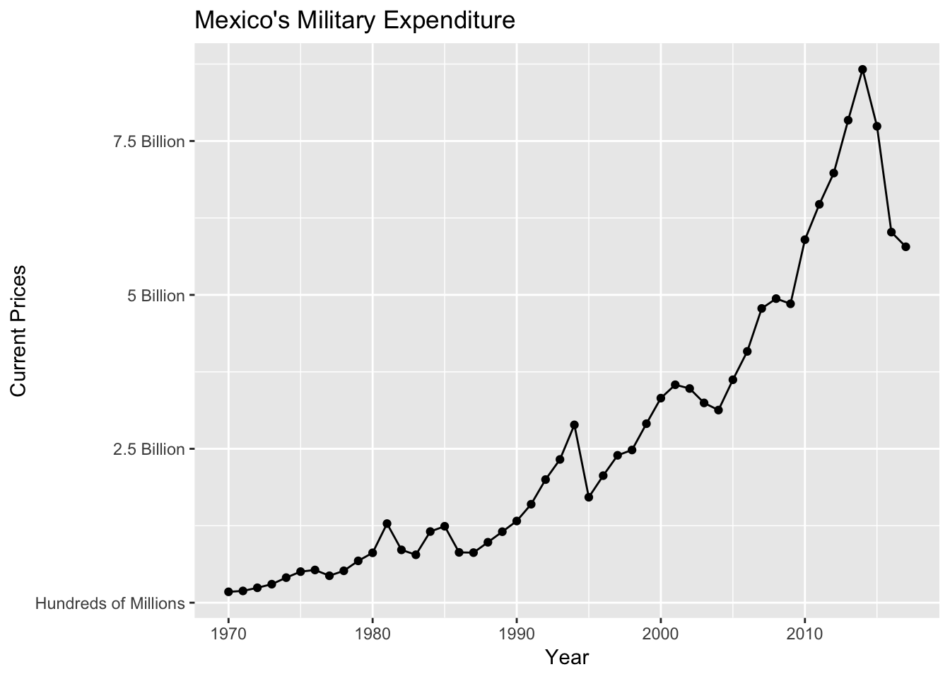
Mexico’s Military Expenditure in Current USD (billions)
Zapatista
Uprising
(1994)
Mexican
Drug War
(2006 – 2019)
Notes:
Mexican Dirty War (1964-1982)
Location: Mexico
An internal conflict between the PRI-led gov’t (Institutional Revolutionary Party) and guerilla/left-wing student groups in the 60s/70s. Gov’t forces carried out around 1200 disappearances, systematic torture and ‘probable extrajudicial executions.’ In 78, left-wing political parties were legalized as well as imprisoned and at large guerillas caused to end militant struggle against the gov’t. It has been said that some groups continued the hostilities until 1982.
Parties involved:
Left-wing groups
Mexico
Supported by: USA
Zapatista Uprising (Jan1-12, 1994)
Location: Chiapas, Mexico
The Zapatista Army of Nat’l Liberation (EZLN) launched an uprising, which lasted 12 days, in that state of Chiapas to protest the enactment of NAFTA. The Mexican gov’t called a ceasefire on 1/12/94, after the Mexican army had driven rebels into the Lancandon jungle.
Parties involved:
EZLN
Mexico
Mexican Drug War (Dec 2006-present)
Location: All over Mexico
An ongoing, low-intensity conflict between the drug syndicates/cartels and Mexican gov’t that began towards the end of 2006 when the military intervened. The goal was to reduce the drug-related violence throughout all of Mexico and dismantle the cartels- whose influence was only growing. Newest elected president has declared an end to the Mexican war on drugs on 1/30/19 and wants to focus on reducing spending (homicides and violence with the cartels has stayed the same or increased since 2006). He also wants to focus the military/police efforts towards stopping the gasoline thefts that have cost the economy around $3billion.
Parties involved:
Mexico (armed forces/ federal police/ state and municipal forces/ self-defense groups)
Drug Cartels (Sinaloa Cartel, Gulf Cartel, Knights Templar Cartel, Jalisco New Generation Cartel, La Familia Michoacana [07-11])

Slide 17
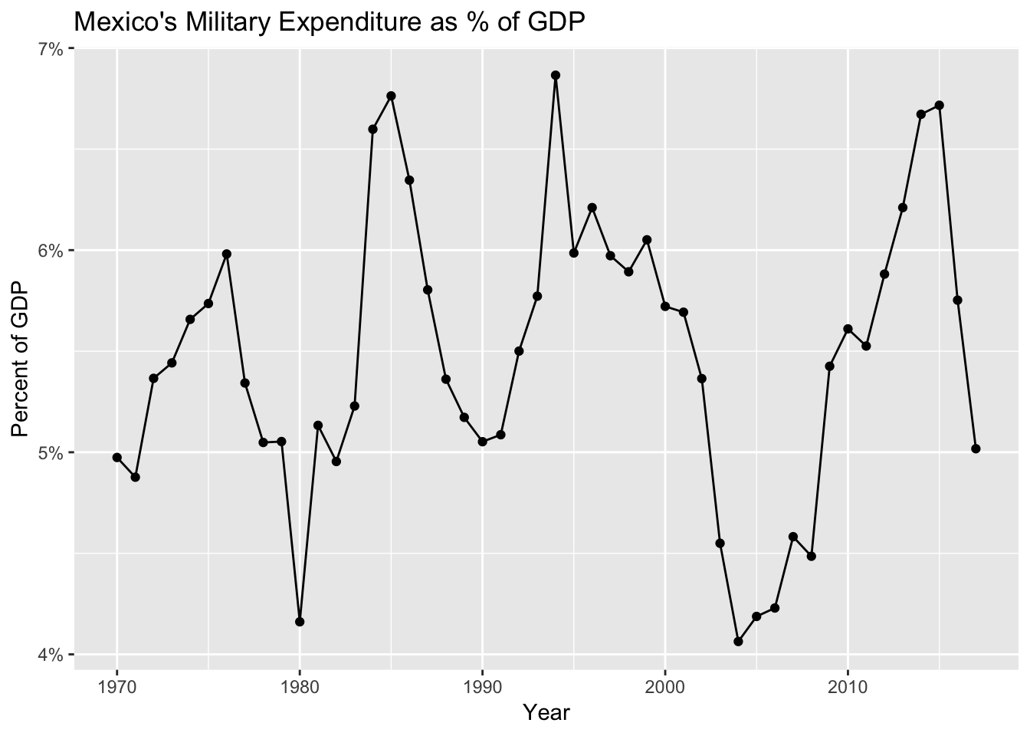
Mexico’s Military Expenditure as % of GDP
Zapatista
Uprising
(1994)
Mexican
Drug War
(2006 – 2019)

Slide 18
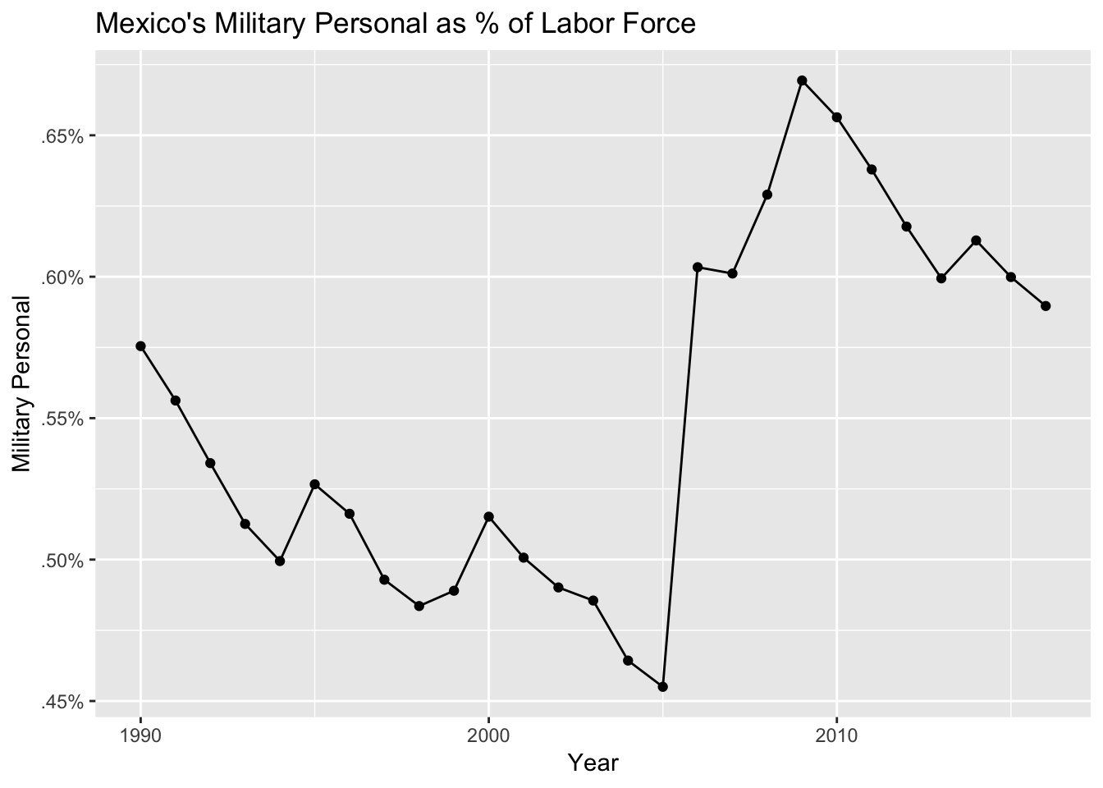
Mexico’s Military Personnel as % of Labor Force
Mexican
Drug War
(2006 – 2019)
Zapatista
Uprising
(1994)

Slide 19
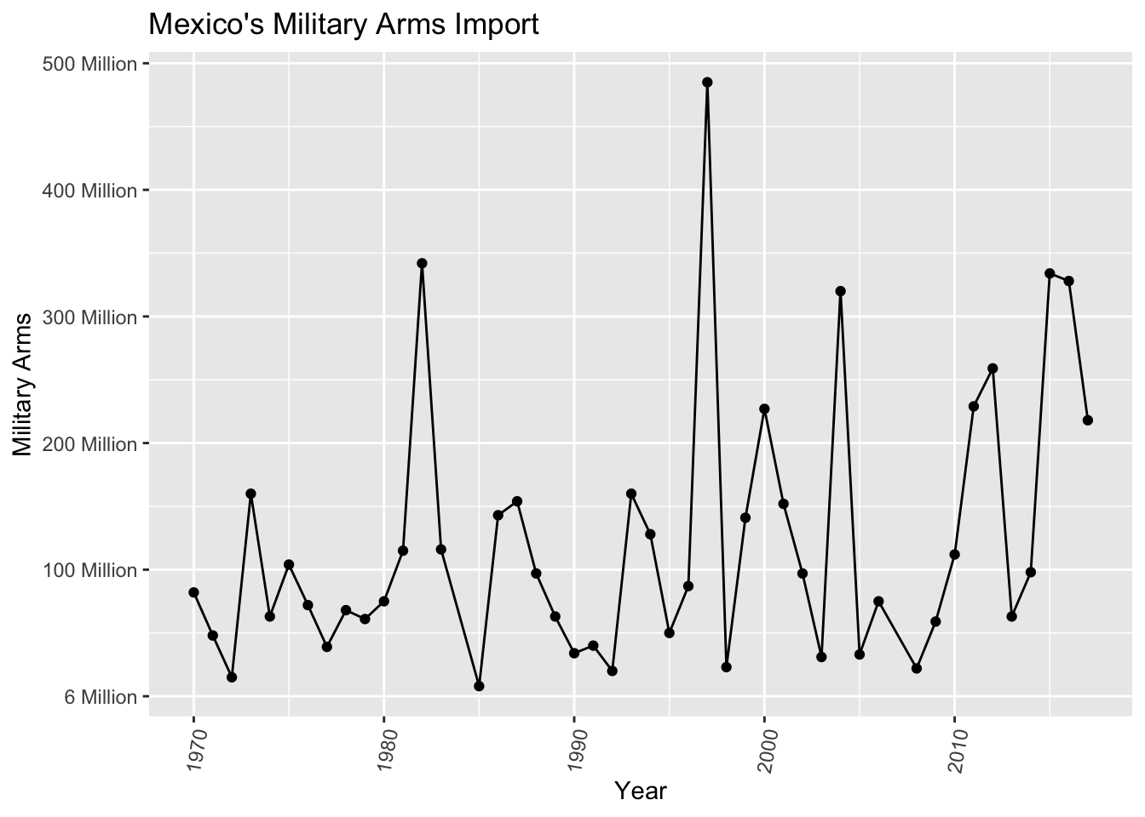
Mexico’s Military Arms Import
Mexican
Drug War
(2006 – 2019)
Zapatista
Uprising
(1994)
Notes:
National Statistics Office (INEGI); Bank of Mexico ; Source of population estimates: UN Population Division's World Population Prospects 2019 PROVISIONAL estimates. Not for circulation. Subject to change.

Slide 20
Conclusion
[Mexico’s military increased]

